Slide 1

AISC1006- Step Presentation Loan Eligibility System
Group Name: D
Course Code: AISC1006
Instructor Name: Usman Ahmad

Slide 2


Loan Eligibility System

Slide 3
Team Members
Mansi Jayeshbhai Sutreja - 500238276
Obianuju Nonyerem Anuma - 500236077
Pavan Kumar Pilli - 500234994
Riya Kalpeshkumar Shah - 500236809
Siddhi Pravinbhai Patel - 500237311
Sri Datta Nadipolla - 500237146
Thejaswee Badepalle -500236954
Yugahang Limbu - 500236054
Arish Panjwani - 500235989

Slide 4

Problem Statement
In the modern financial landscape, the influx of loan applications poses a significant challenge for institutions. Manual evaluation of these applications is time-consuming and prone to errors. To streamline this process, our task is to leverage machine learning techniques and algorithms to build a loan eligibility prediction system to help aid and streamline the process of approve or reject loan request.

Slide 5

Objective
Design a robust loan eligibility prediction Machine learning model
Accurately assess the creditworthiness of loan applicants
Expedite decision-making for financial institutions
Mitigate risks associated with lending

Slide 6

INITIAL PROJECT MANAGEMENT REPORT

Slide 7

Plan of Action
Choose dataset early and start working
Assign roles and closely monitor progress
Hold meetings for updates and coordination
Submit project works by 24th May

Slide 8
Meeting Documentation
Date | Meeting Type (online or offline) | Content of Discussion
11-05-24 | Offline Meeting (Recreation Room) | Discussed skills and ideas, chose dataset, assigned roles
14-05-24 | Offline Meeting (Student Lounge) | Explored topic, discussed problem statement and platform
16-05-24 | Online (MS Teams) | Discussed report and slides preparation
21-05-24 | Offline (In Class) | Coordinated work on assigned tasks
24-05-24 | Online (MS Teams) | Finalized report and PPT

Slide 9

Solution Flow/Project Flow
Problem Definition and Data Collection:
Clearly define the problem we want to solve.
Collect the Dataset
Data Preprocessing:
Clean the data.
Exploratory Data Analysis (EDA):
Visualize the data (histograms, scatter plots, etc.).
Understand the distribution of features.
Identify patterns, correlations, and anomalies.
Feature Engineering:
Select relevant features based on domain knowledge and Insights from EDA.
Data Splitting:
Divide the data into training, validation, and test sets.

Slide 10

Solution Flow/Project Flow
Model Selection:
Choose appropriate algorithms
Model Training & Evaluation:
Train the selected model using the training data.
Evaluate the model’s performance using validation data (accuracy, precision, recall, etc.).
Model Tuning:
Optimize model hyperparameters
Model Validation and Visualization:
Validate the tuned model on the test set.
Visualize model predictions and compare them with actual values.
Conclusions:
Analyse the model’s performance.
Draw conclusions based on the results.

Slide 11

Dataset
Data Source
Kaggle
https://www.kaggle.com/datasets/architsharma01/loan-approval-prediction-dataset

Slide 12
Understanding the Data Set (Features)
1. loan_id
Unique Id of Loan
2. no_of_dependents
Number of Dependents of the Applicant
3. education
Education of the Applicant:
Graduate/Not Graduate
4. self_employed
Employment Status of the Applicant
5.income_annum
Annual Income of the Applicant
6.loan_amount
Applied Loan Amount
7. loan_term
Loan Term in Years
8. cibil_score
Credit Score of the applicant
9. residential_assets_value
Residential Assets Value of the Applicant
10. commercial_assets_value
Commerical Assets Value of the Applicant
11. luxury_assets_value
Luxury Assets Value of the Applicant
12. bank_asset_value
Current Bank Balance of the Applicant
13. loan_status
Loan Approval Status:
Approved/Rejected

Slide 13
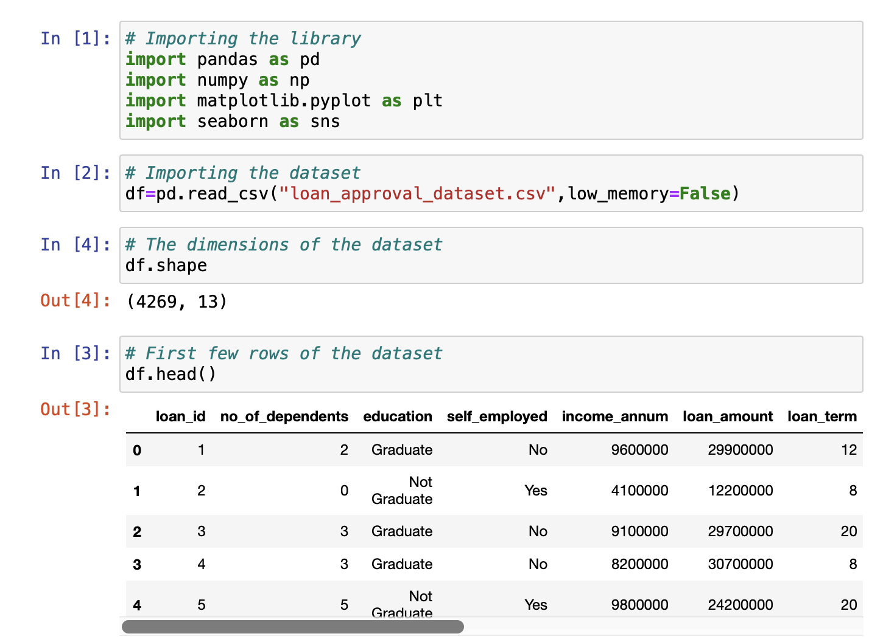
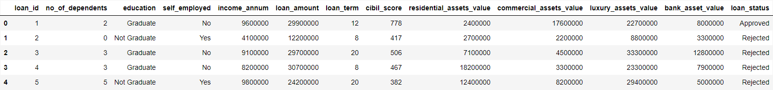
Loading The Data Set

Slide 14
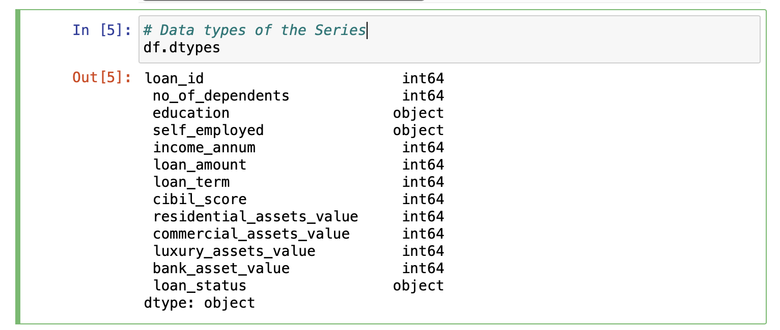
Data Types of Features

Slide 15
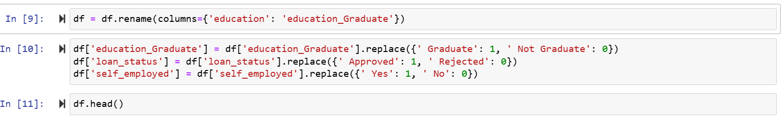
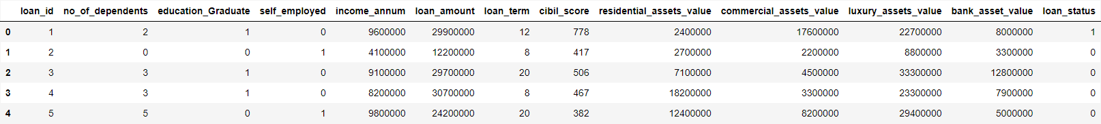
Converting Yes/No data to 1/0 data

Slide 16
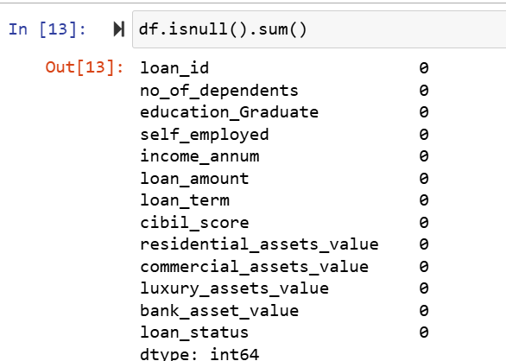
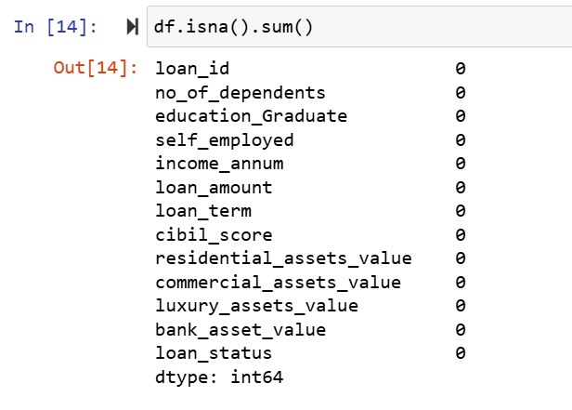
Checking For Null and NaN Values

Slide 17
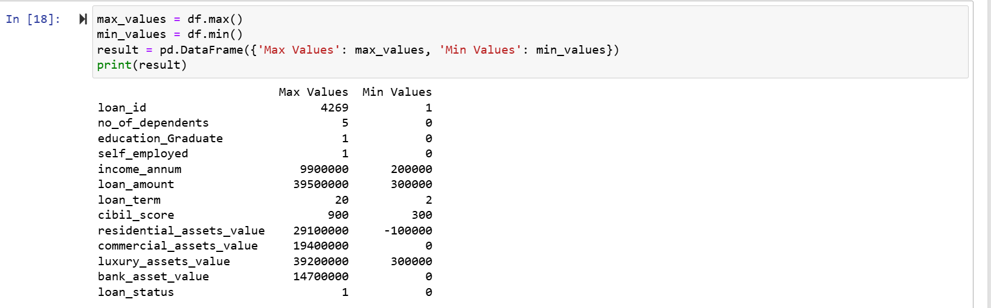

Maximum and Minimum Values of Features
Here If you Observe Minimum Value of residential_Assets_value is in Negative Value. So, it is not making any sense.

Slide 18
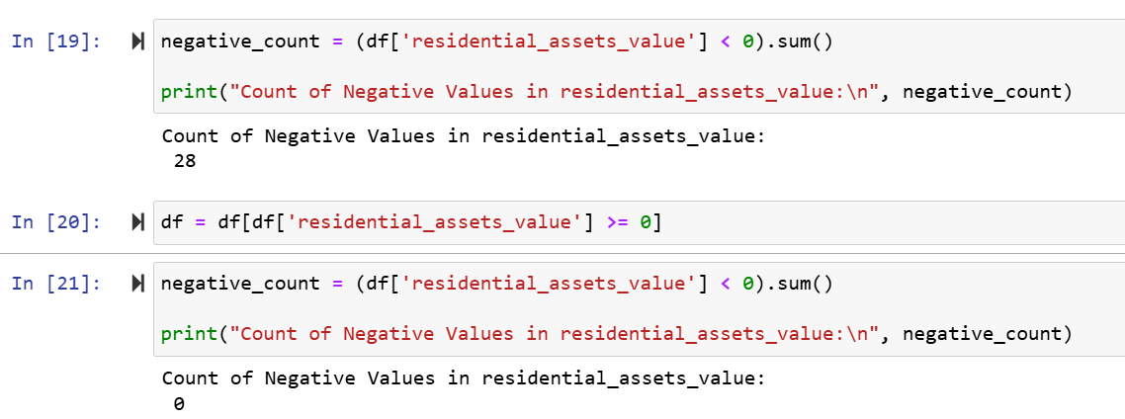
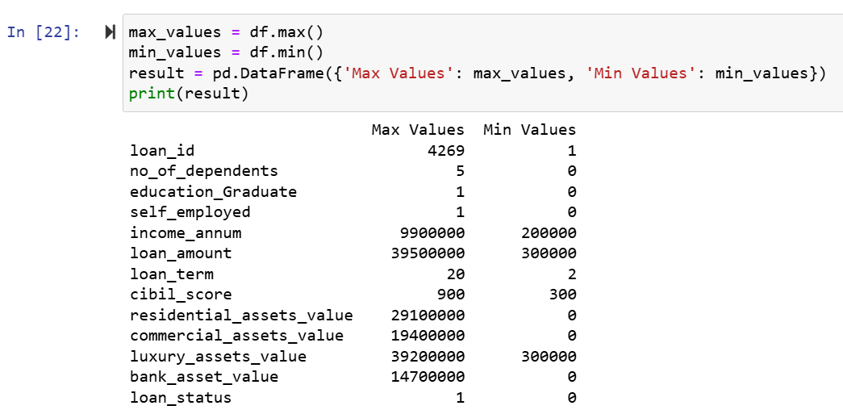



Removing Negative Values

Slide 19
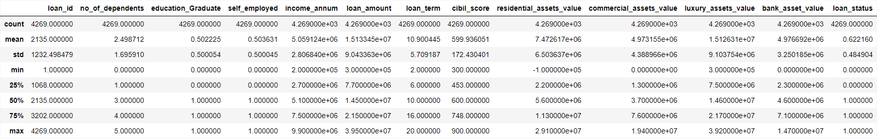
Summary of Descriptive statistics

Slide 20
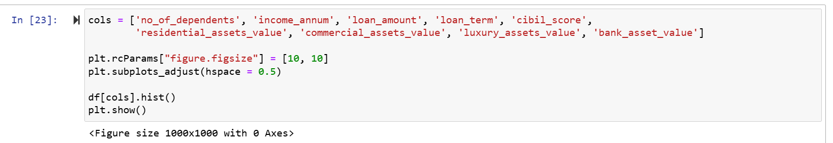
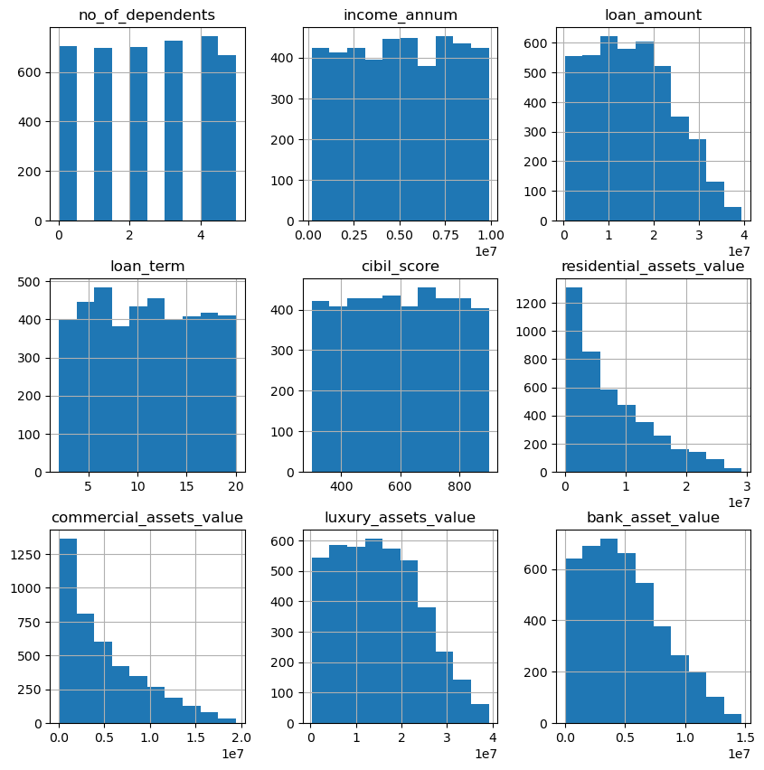

Histograms of Features

Slide 21
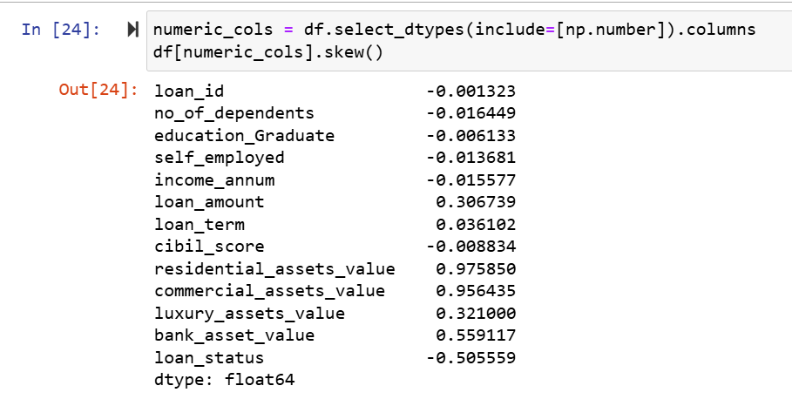
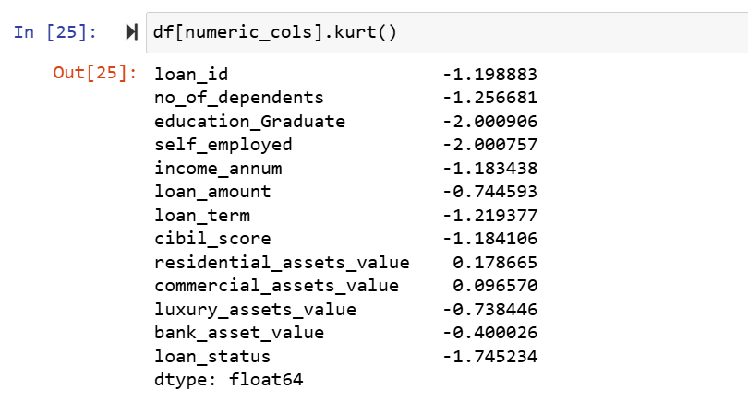
Skewness and Kurtosis
Kurtosis < 3: It is platykurtic,
Kurtosis > 3: It is leptokurtic
Negative value indicates left skew, Postive Value indicates Right Skew

Slide 22
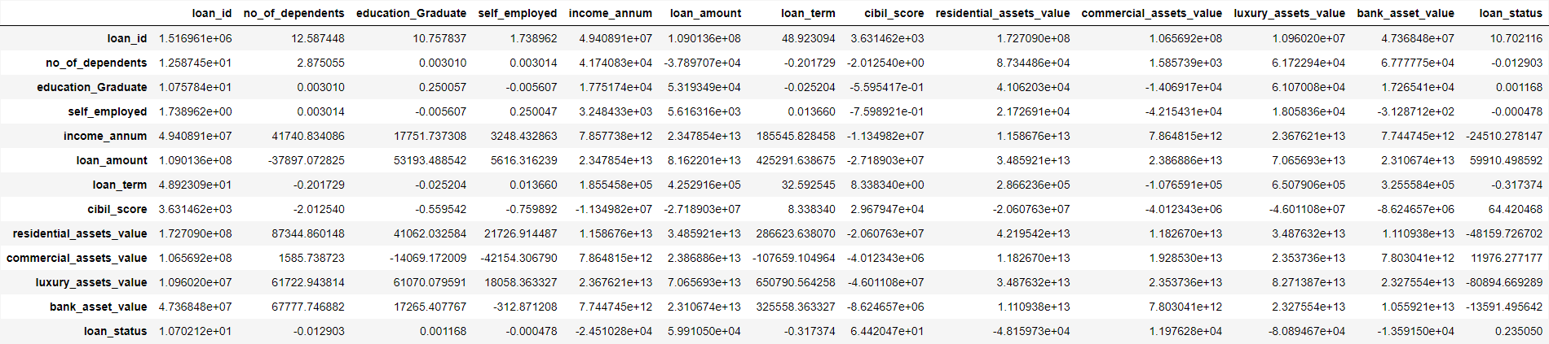
Covariance
values can range from negative to positive infinity
Covariance indicates whether the variables tend to move together (positive covariance) or move in opposite directions (negative covariance)

Slide 23
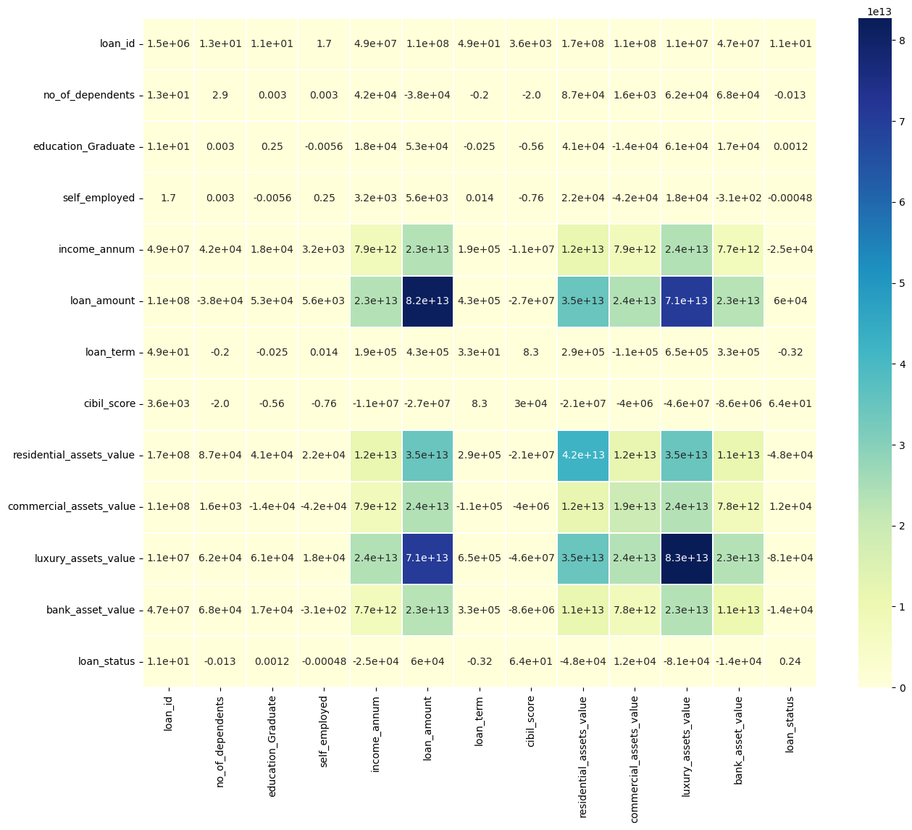
Covariance Matrix

Slide 24
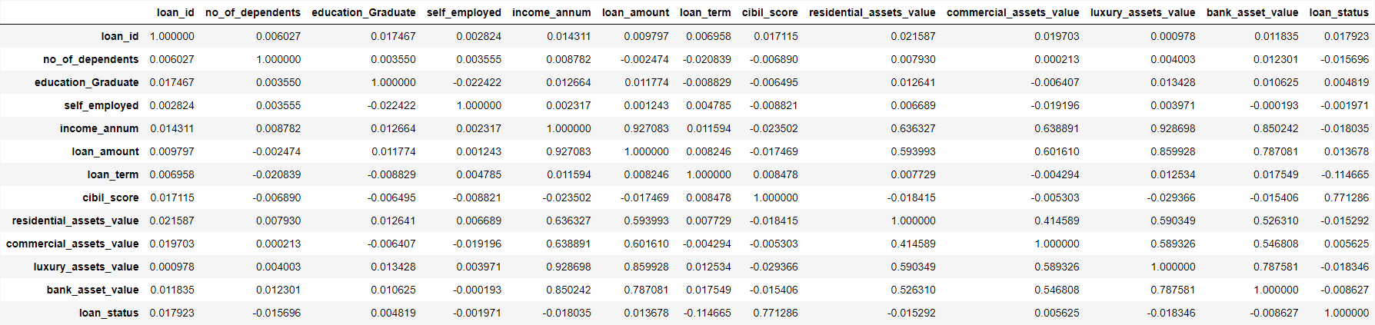
Correlation
Values can range from -1 to +1
Correlation indicates whether the variables tend to move together (positive correlation) or move in opposite directions (negative correlation)

Slide 25
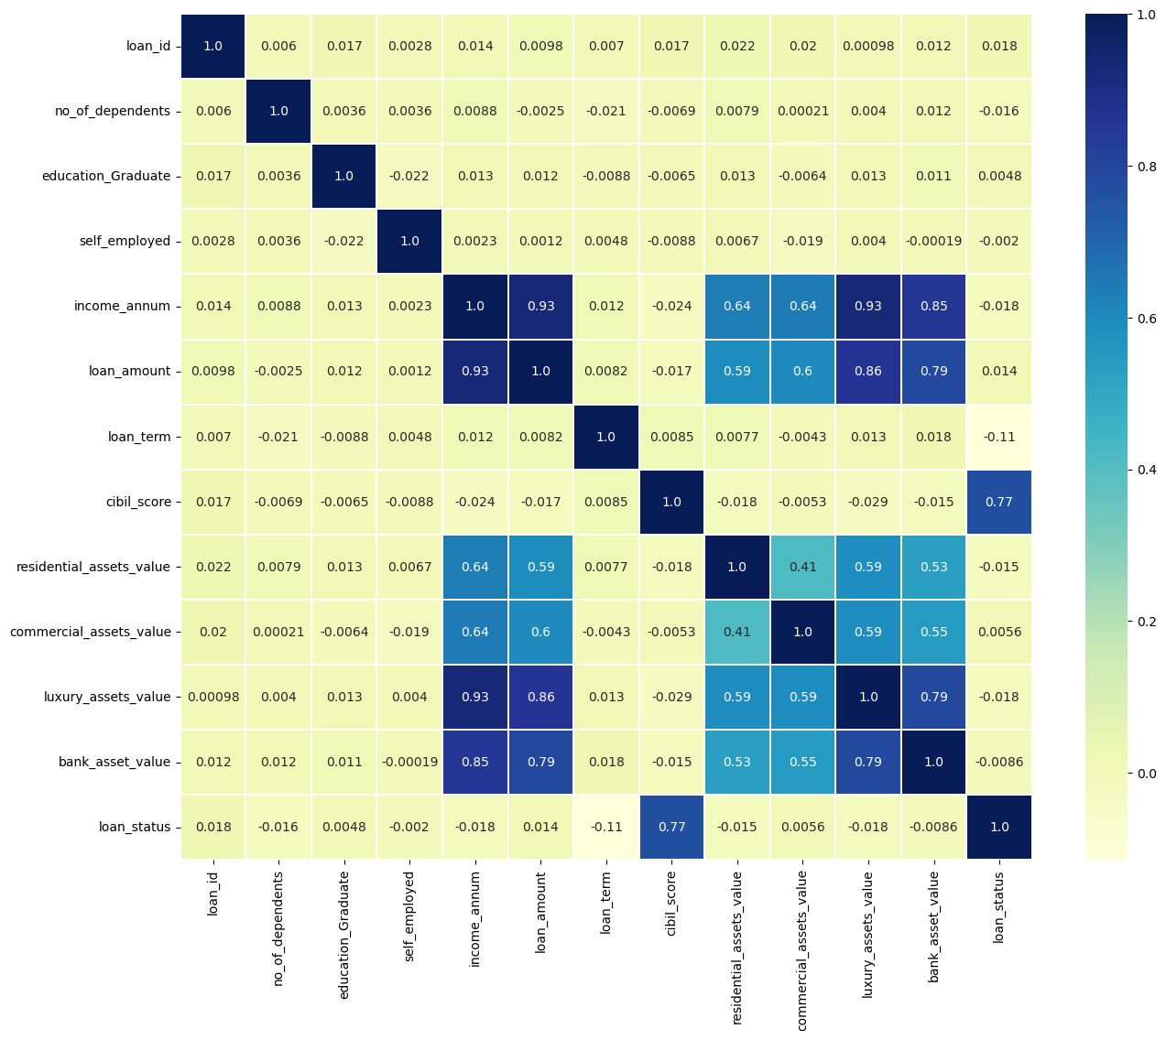
Correlation Matrix

Slide 26
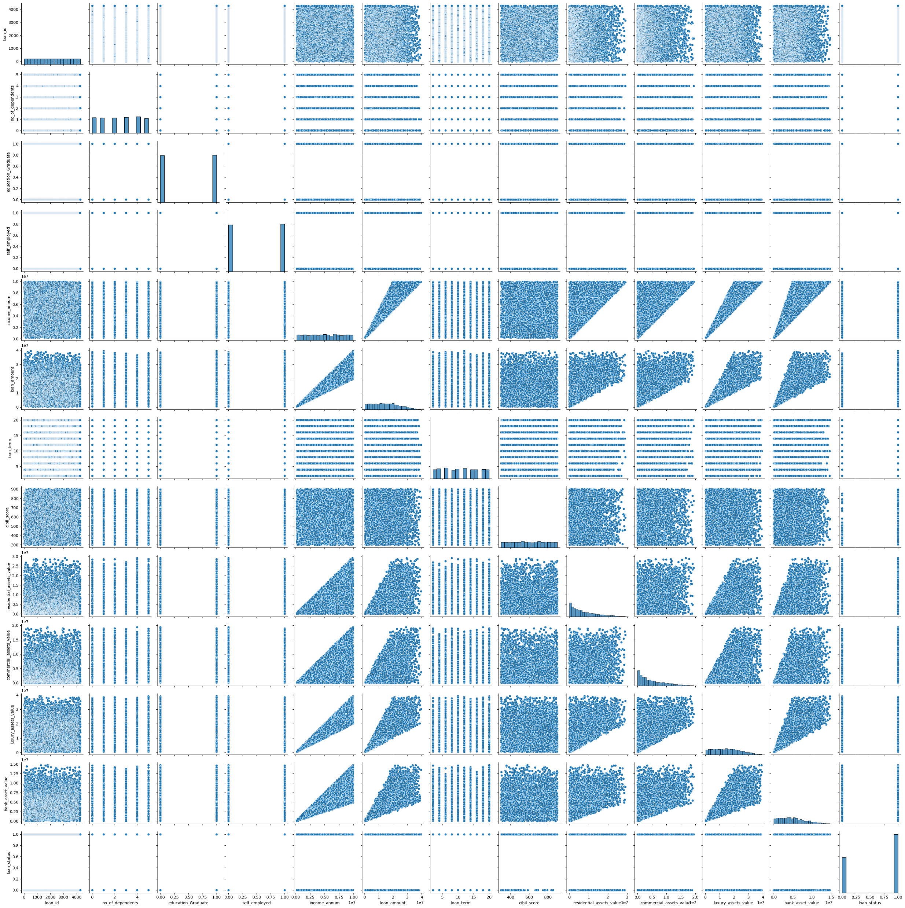
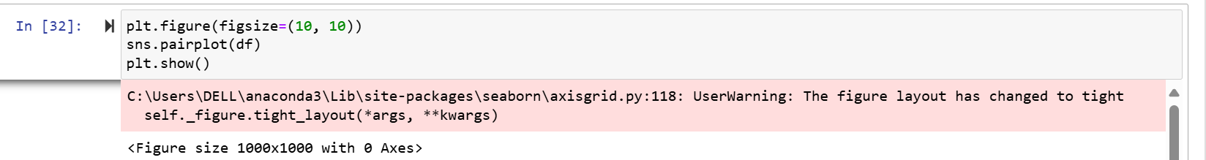
Pair Plots

Slide 27
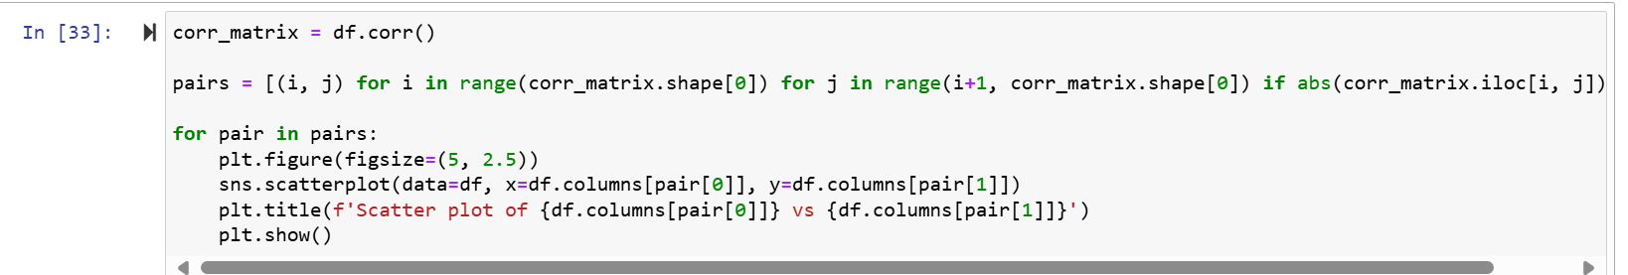
Pair Plots for Features having correlations greater than 0.3

Slide 28
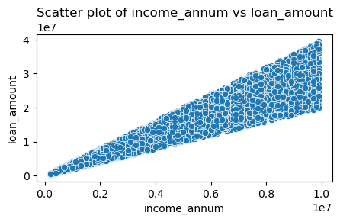
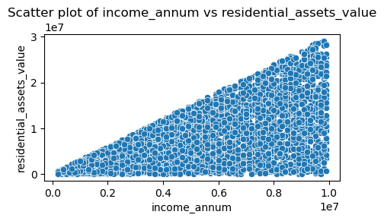
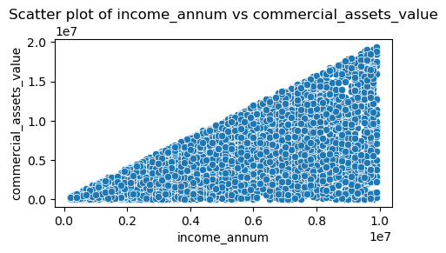
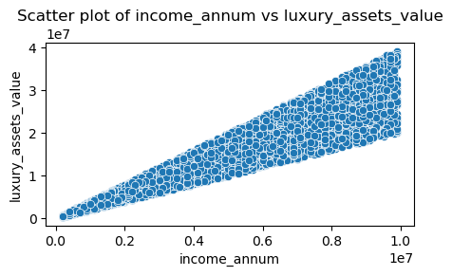

Slide 29

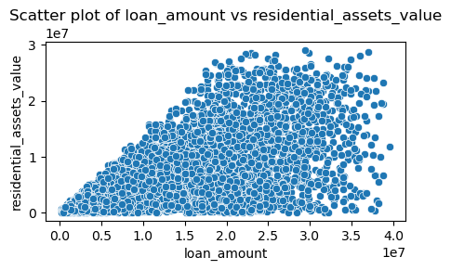
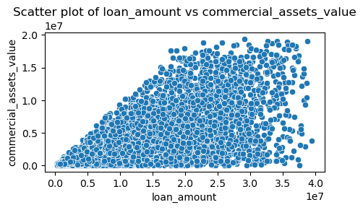
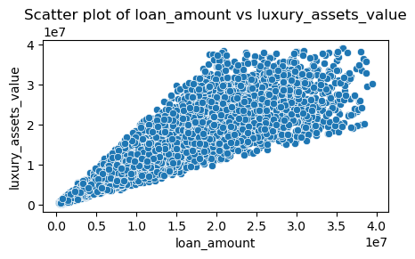

Slide 30
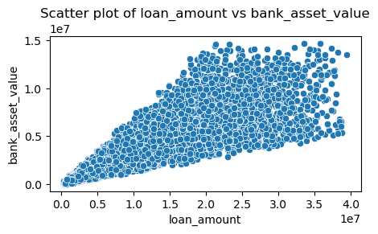
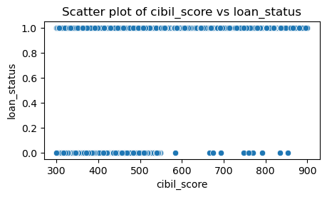
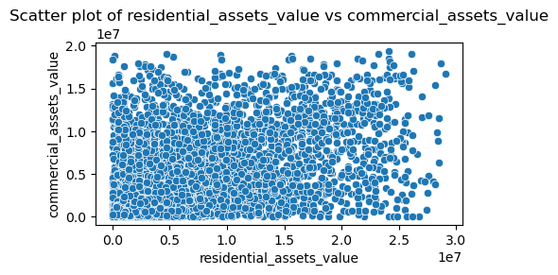
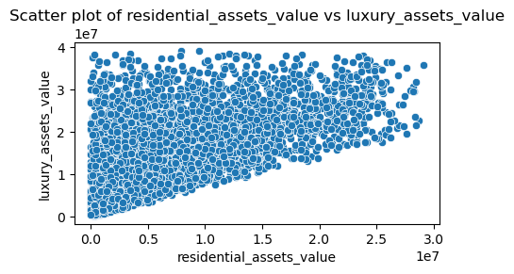

Slide 31
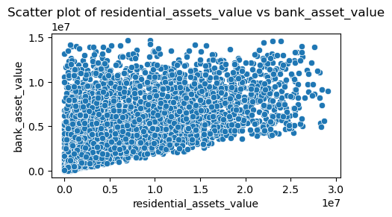
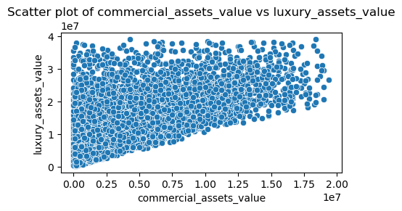
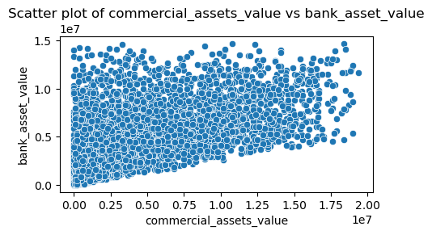
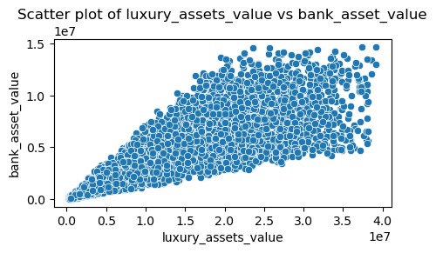

Slide 32
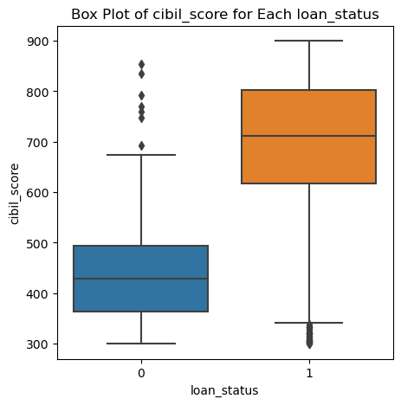
Box Plot for Loan status vs Cibil score

Slide 33

Observations
*As of now
Income and Loan Dynamics:
Strong linear relationship between income and loan amount. Higher income individuals are more likely to obtain larger loans and possess valuable assets.
CIBIL Score and Loan Status:
CIBIL score plays a critical role in determining loan status, as evidenced by their strong positive correlation and covariance. A good CIBIL score increases the likelihood of a favorable loan status.
Asset Values:
Luxury and residential asset values are strongly associated with both income and loan amount. Applicants with higher incomes and larger loans tend to report higher asset values, indicating financial stability and creditworthiness.
Visual Patterns:
Pair plot confirms the linear relationships observed in the correlation matrix and highlights the distribution of data points. Clear trends in scatter plots align with statistical measures, providing a holistic understanding of data relationships.

